Slide 1
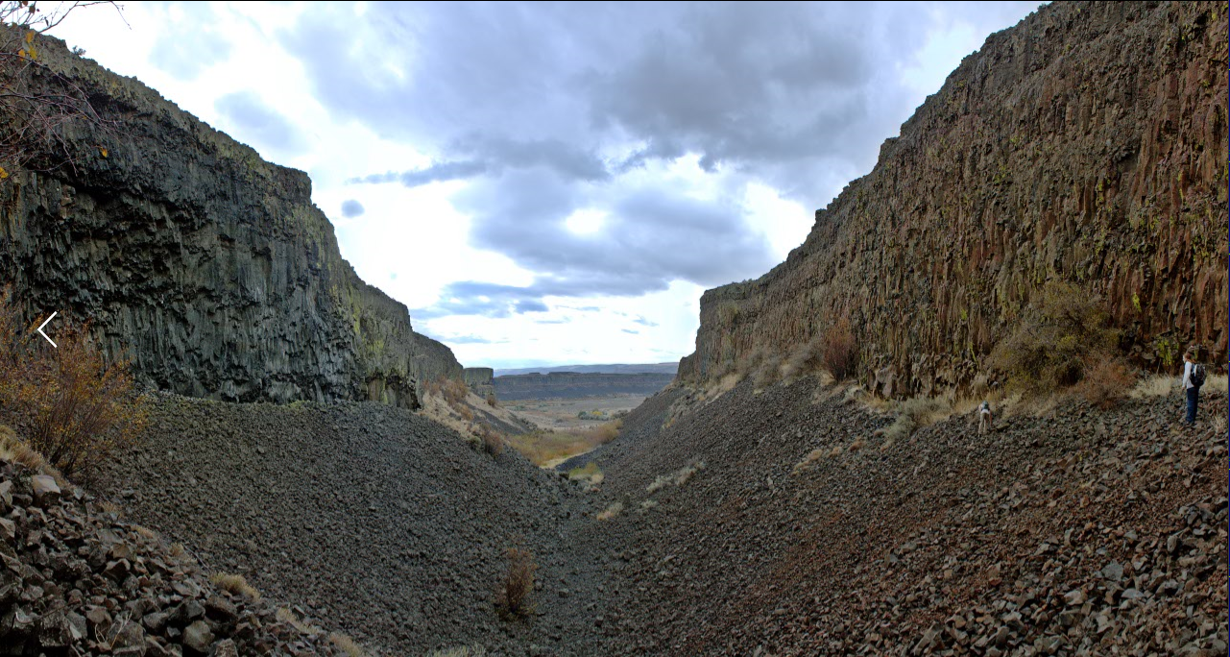
Parallel LSB Steganography
Mavericks

Slide 2
Steganography
Not Cryptography
But oftentimes used in combination.
Hiding information in plain sight.
Very difficult to detect although there do exist ways of testing and image for tampering using statistical analysis.

Slide 3
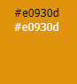
Least Significant Bit
Why the least significant bit?
Representing Characters
8 pixels per character
Our approach only changes the LSB of the red value of the pixel that is being transformed.
1110 0000 1001 0011 0000 1101

Slide 4
Memory Limitations of this Approach
Header Size (bits) | Maximum Characters Encrypted | Image Size Needed (Pixels) | Approximate Image Dimensions
1 | 1 | 9 | 3 by 3
2 | 3 | 26 | 5 by 5
4 | 15 | 124 | 12 by 12
8 | 255 | 2048 | 45 by 45
16 | 65,535 | 524,296 | 720 by 720
24 | 16,777,215 | 134,217,744 | 11,500 by 11,500
32 | 4,294,967,295 | 34,359,738,392 | 185,000 by 185,000

Slide 5
Parallelism and Message Passing Interface (MPI)
What is Parallelism?
Execution of processes carried out simultaneously.
What is MPI?
The standard communication protocol for parallel programming.

Slide 6

512 x 512
512 x 512
= 262,144 pixels
262,144 pixels / 8(pixels/char)
= 32,768 chars

Slide 8


Slide 9
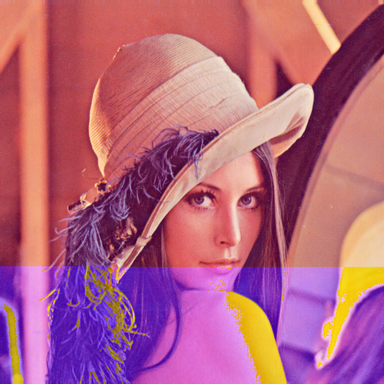

Slide 10


Slide 11
5458 x 2915
5458 x 2915 = 15,910,070 pixels
15,910,070 pixels / 8(pixels/char)
= 1,988,758 chars

Slide 13
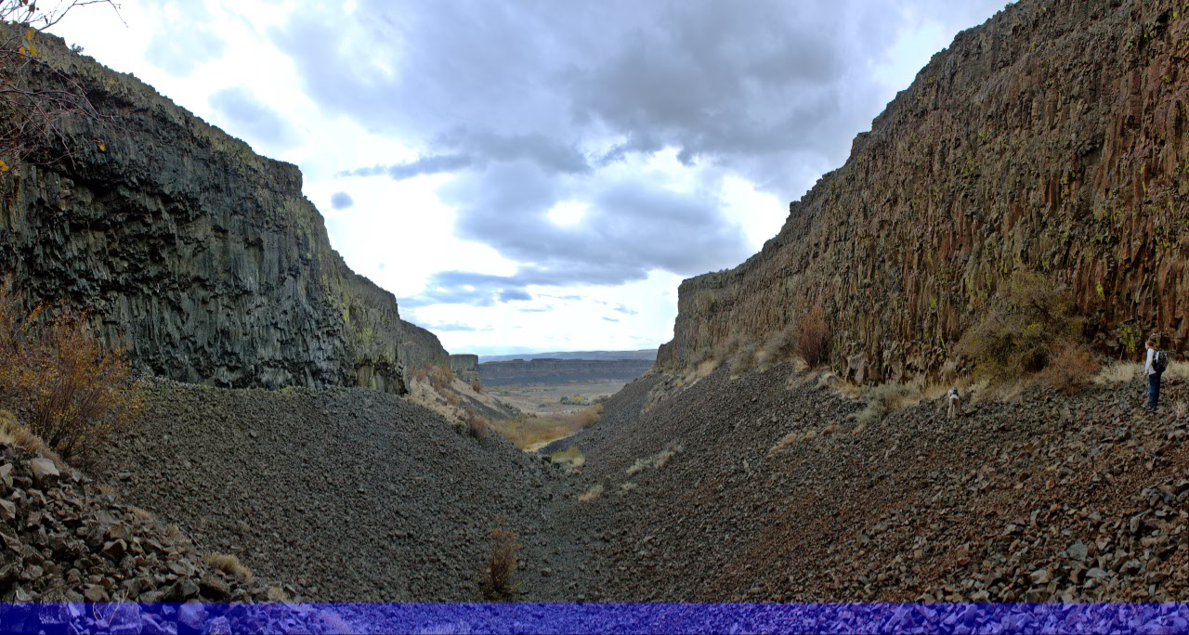

Slide 14
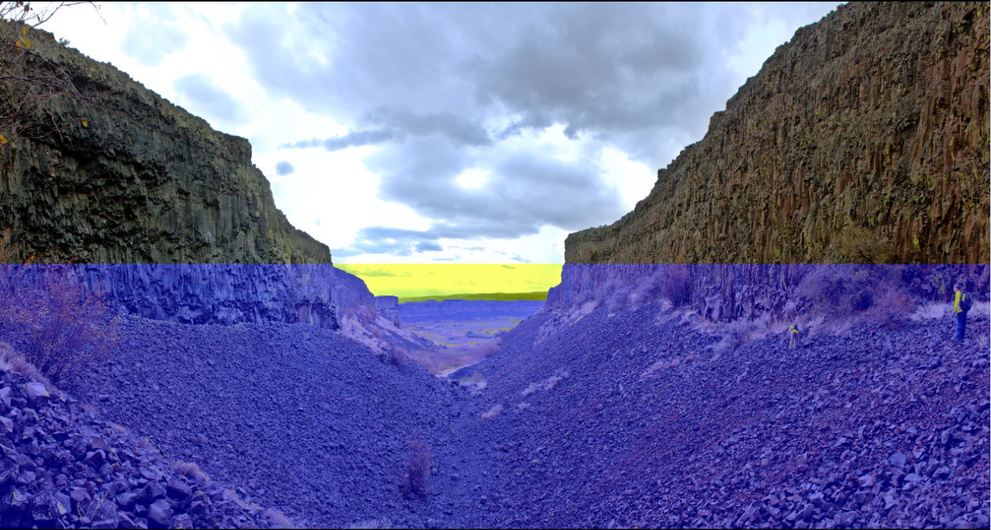

Slide 15
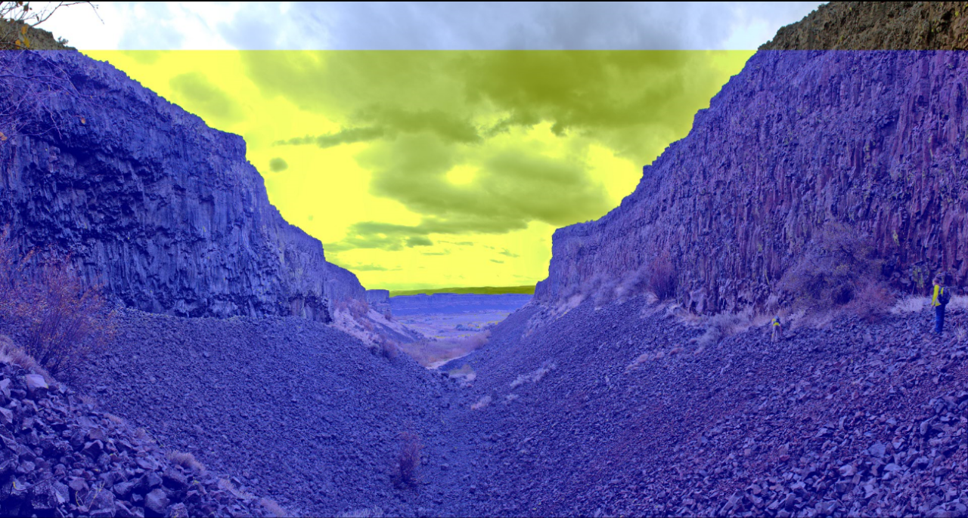

Slide 16
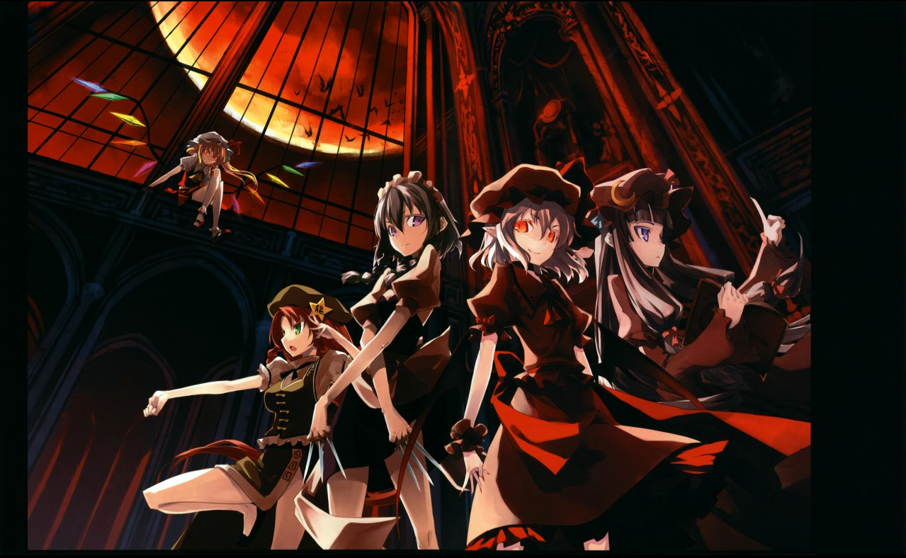
9893 X 6043
9893 X 6043 = 59,783,399 pixels
59,783,399 pixels / 8(pixels/char)
= 7,472,924 chars
7,472,924 chars / (3chars/pixel)
= 2,490,974 pixels
That’s almost 10 of the original 512 x 512 image!

Slide 18
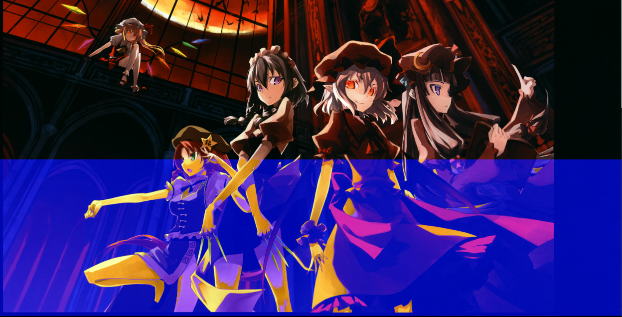

Slide 19
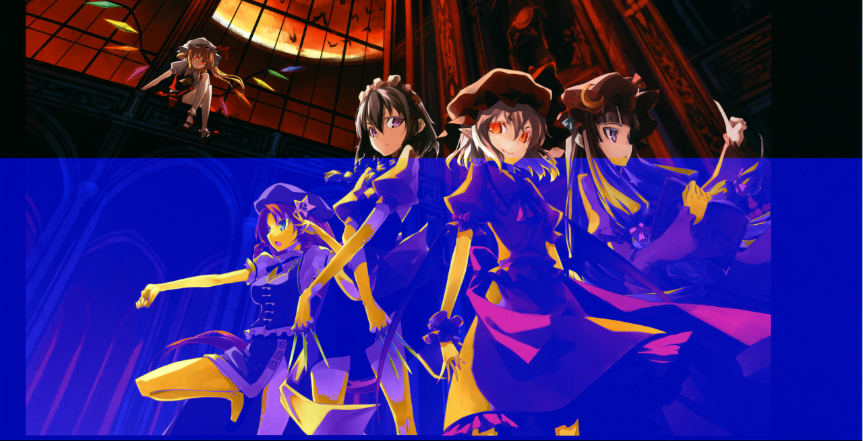

Slide 20
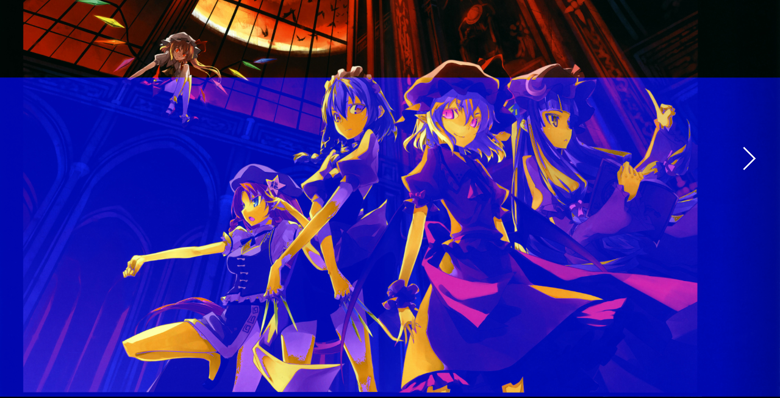

Slide 21
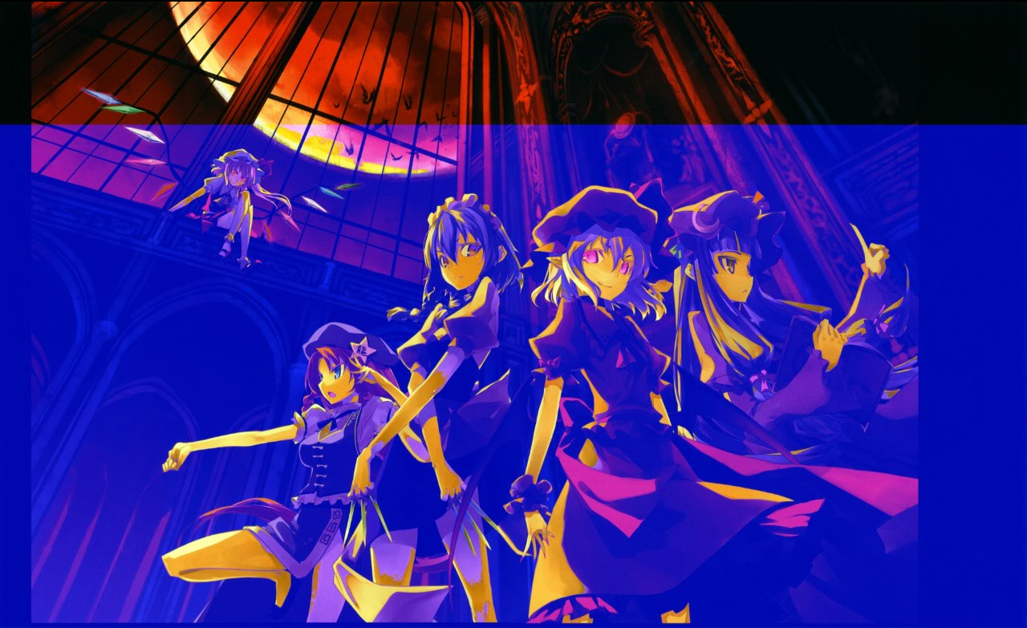

Slide 23
Results

Slide 28
Questions?

